Slide 1
RESEARCH METHODS
for
COMPUTING & TECHNOLOGY

Slide 2


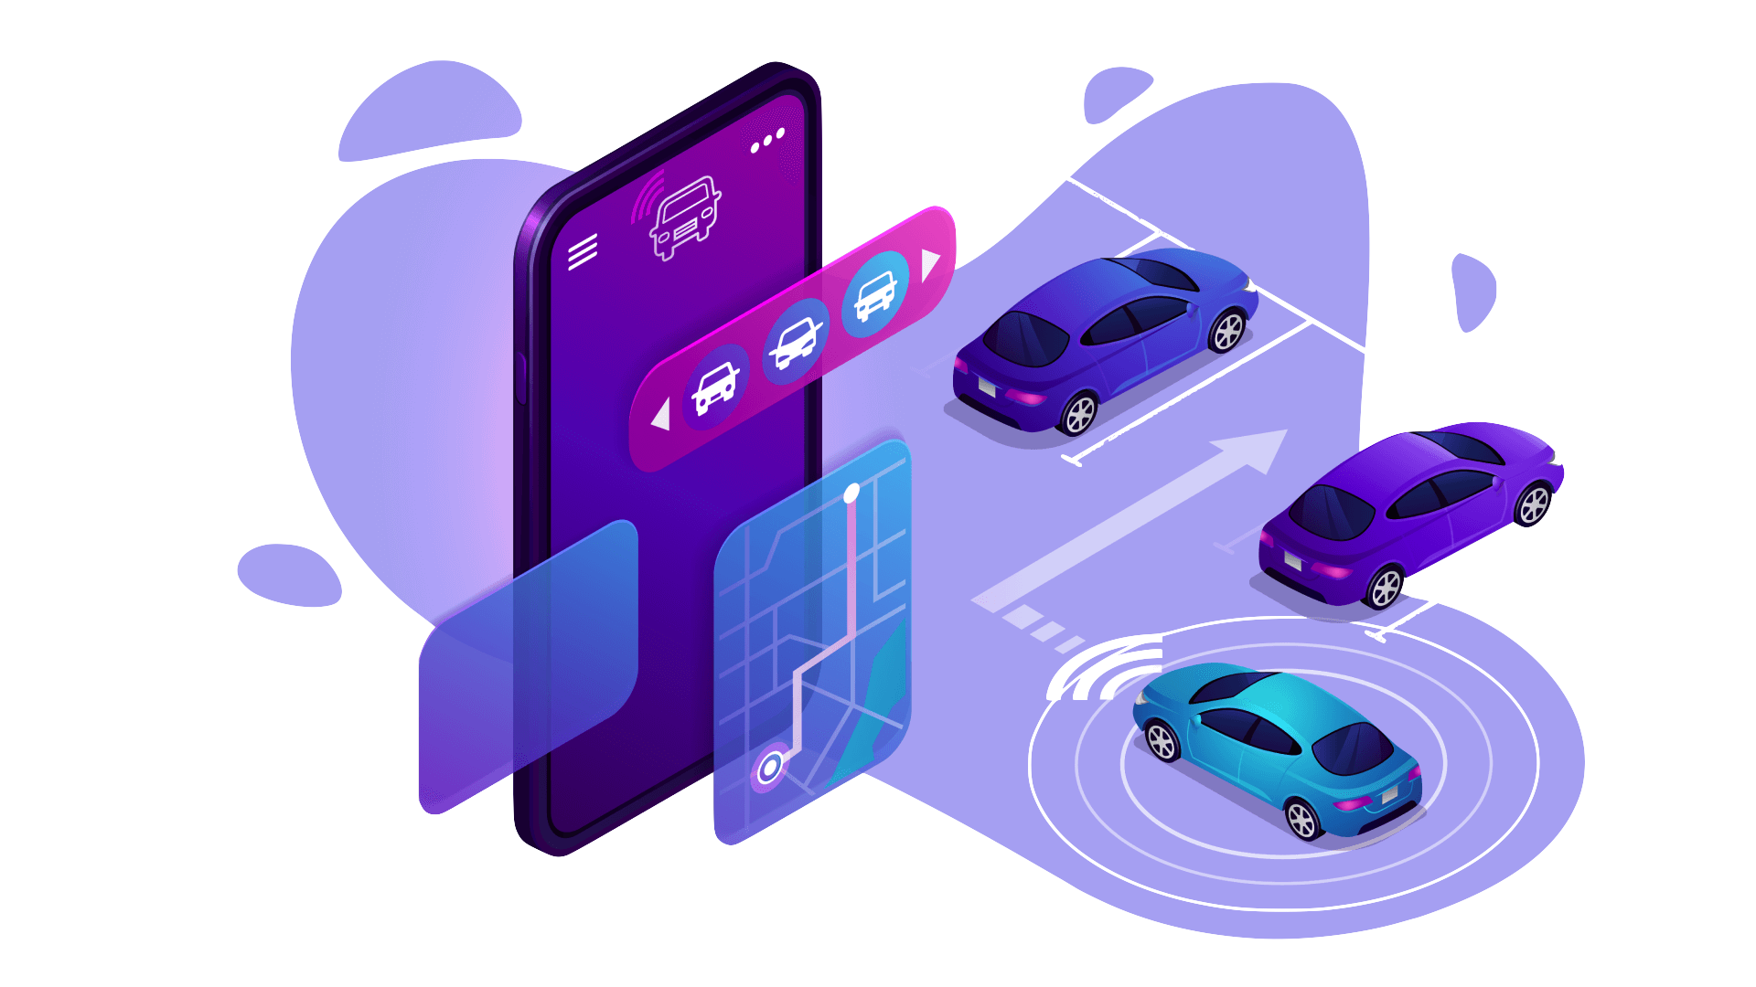

CLASS PRESENTATION
IoT Based,
ADVANCED
CAR PARKING SYSTEM
11th March, 2022
Presenting to,
Sandesh Subedi ‘A’
1
Mr. Anup Adhikari Sir
NPI000040

Slide 3







ABSTRACT
Concept of ‘Advanced Car Parking System’
Based on IoT and operated with Mobile Application
Focus on minimizing extensive traffic congestion
Consequences claims to provide sufficient parking
whilst saving time and fuel energy

Slide 4

INDEX TERMS
Advanced
Parking
IR Sensors
Traffic
Congestion
Internet
of
Things
Mobile
Application

Slide 5
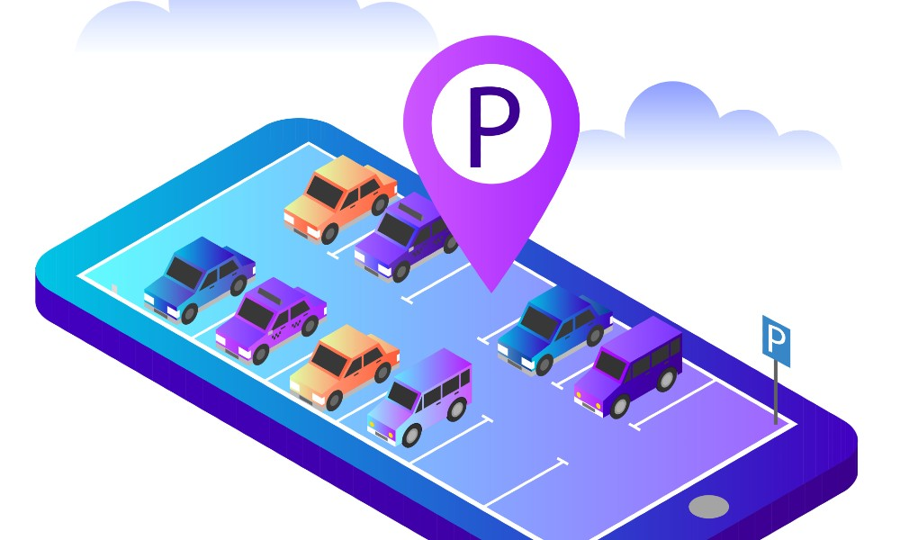
INTRODUCTION
Rise in automobile has given rise to some serious challenges (eg. Traffic jams and insufficient parking, etc.)
Traffic jam has costed around 116 billion rupees
in Kathmandu city only (Chand, 2021)
Traffic jam has costed around 116 billion rupees
in Kathmandu city only (Chand, 2021)
Use of efficient IoT actuators and sensors can
definitely play vital role in advanced parking system
Incorporates usage of devices such as IR sensors,
LED matrix indicators and microcontroller

Slide 6

LITERATURE REVIEW
As noted by Adler (2016), the city of Barcelona has provided automobile drivers with a sensor system that automatically escort them towards the vacant parking spaces. It was found that around 4,000 authorizations were issued each day with this concept of parking.
Niculescu et al. (2015) put forward an idea of intelligent driver assistant also known as IDA. IDA, unlike most of other applications would interact to drivers via speech. Their intention is to eliminate traffic congestion caused due to poorly managed traditional parking.

Slide 7



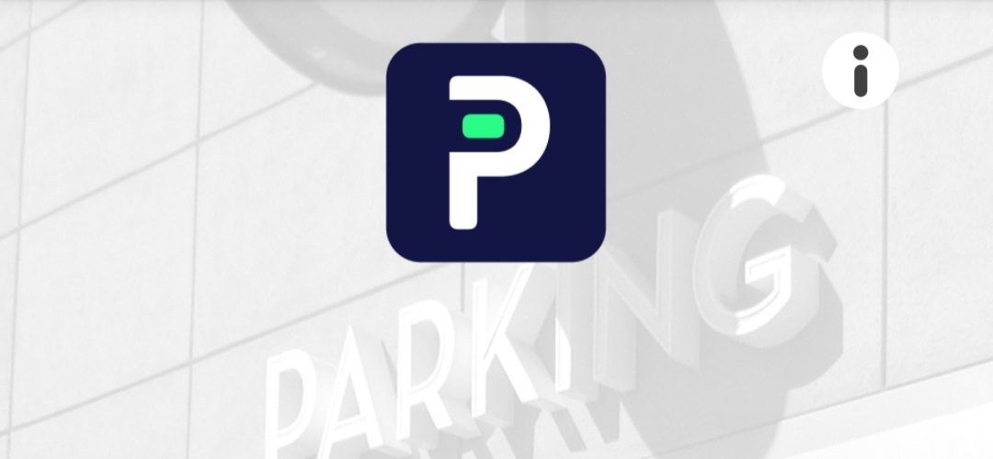
SIMILAR SYSTEMS
Canada based smart parking app
Application available in 15,000 cities
Allows their users to reserve vacant
space to park their cars
Allows users allows users to find and
book parking spot using current address
Sends timely notifications and offers
Online payment as well
Provides real-time information to users,
showing space, cost and parking time

Slide 8


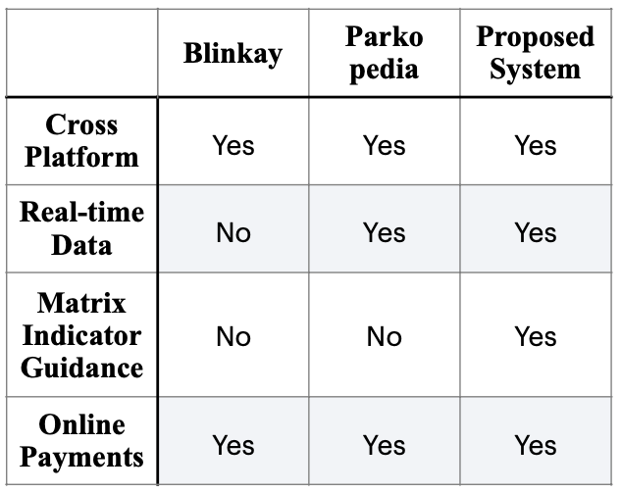
COMPARISON BETWEEN
AVAILABLE AND PROPOSED SYSTEMS

Slide 9
PROBLEM STATEMENT
A research from Weishuber (2015) claims that around 40% of accidents occur during vehicle parking.
Traditional and road- side parking causes huge traffic congestion which results in loss of fuel, energy and time.
A driver has to drive aimlessly for hundreds of meters just to find a vacant space to park his car.

Slide 10

RESEARCH AIMS
To establish an IoT based car parking system that will facilitate users with convenient parking service and reduce traffic congestion in manifold locations.
RESEARCH OBJECTIVES
Provide facile parking service to diminish time wastage and fuel consumption.
Differentiate and contrast similar systems to find out problem gap
To implement the parking system by April 2023, reducing traffic congestion by 60% and making environment carbon free.

Slide 11

RESEARCH QUESTIONS
What would be the impact of advanced parking system to automobile owners?
How does the use of LED matrix indicator benefits car owners?
What role will IoT play in controlling the traffic congestion with advanced parking system?
Determine both hardware and software components that will be essential for the development of advanced parking system
Specify the procedures in pre-booking a parking slot through a mobile application

Slide 12

RESEARCH SIGNIFICANCE
New intuition into the concept of traditional parking system.
Save time as well as the amount of fuel consumed.
Ensures vehicle safety and outstandingly reduce road congestion.
Convenient parking experience without any blockages or obstructions.

Slide 13


METHODOLOGY
SURVEY
Chosen Method : Questionnaire
Questionnaire to be conducted in two ways : virtually and physically
To be conducted among 120 - 150 vehicle owners and drivers within 5 days
Set of questions to be posted online for online survey

Slide 14

SAMPLING
Chosen Type : Purposive Sampling
Choosing impactful population (eg. Drivers, car sellers and owners)
Including traffic officers as the research aims in traffic fluency and road safety as well
Additional information will be gathered regarding parking ideologies

Slide 15

OVERVIEW OF PROPOSED SYSTEM
Advanced Car Parking System
A modern notion of parking system
Easy parking slots reservation via mobile application
Can simply log in, check details and pay from the system
Use of IoT and hardware components

Slide 16

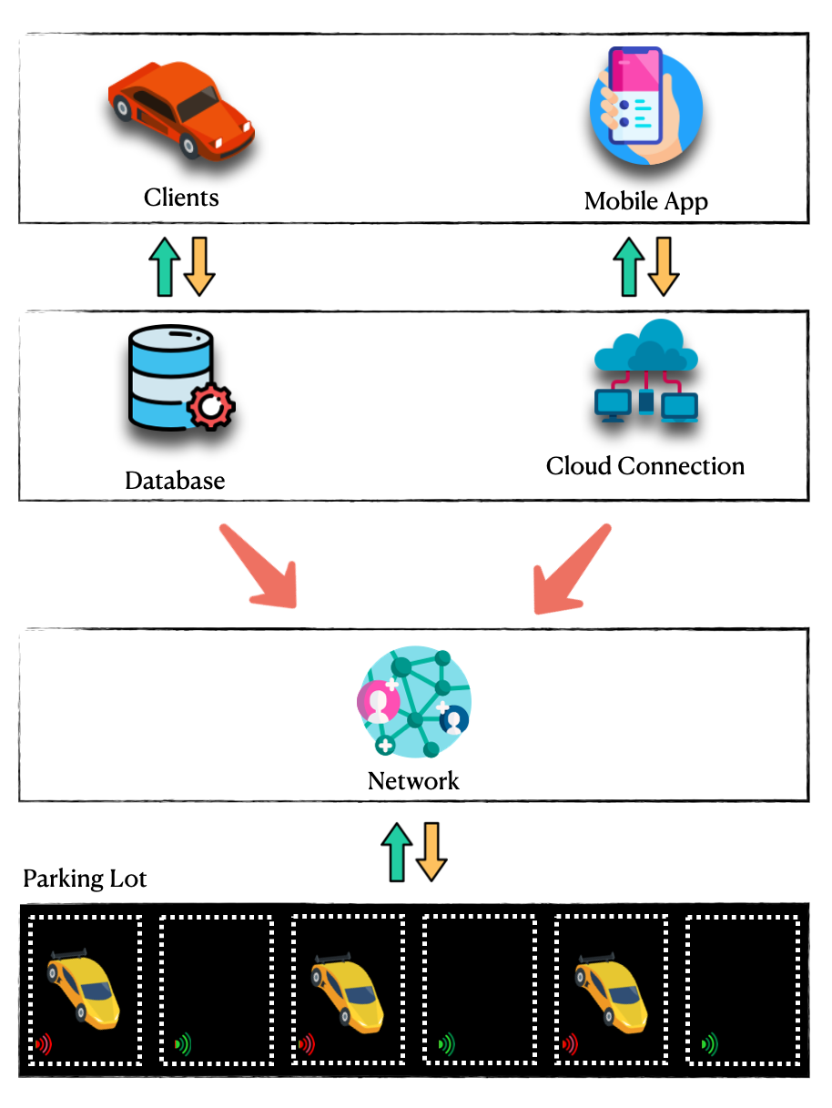


ARCHITECTURE OVERVIEW
Architecture Components
Application Layer
User-system Interaction
Network Layer
Communication among stations
& integrated systems
Transaction Layer
Nodes transaction in network
Physical Layer
Mechanisms and IoT devices

Slide 17
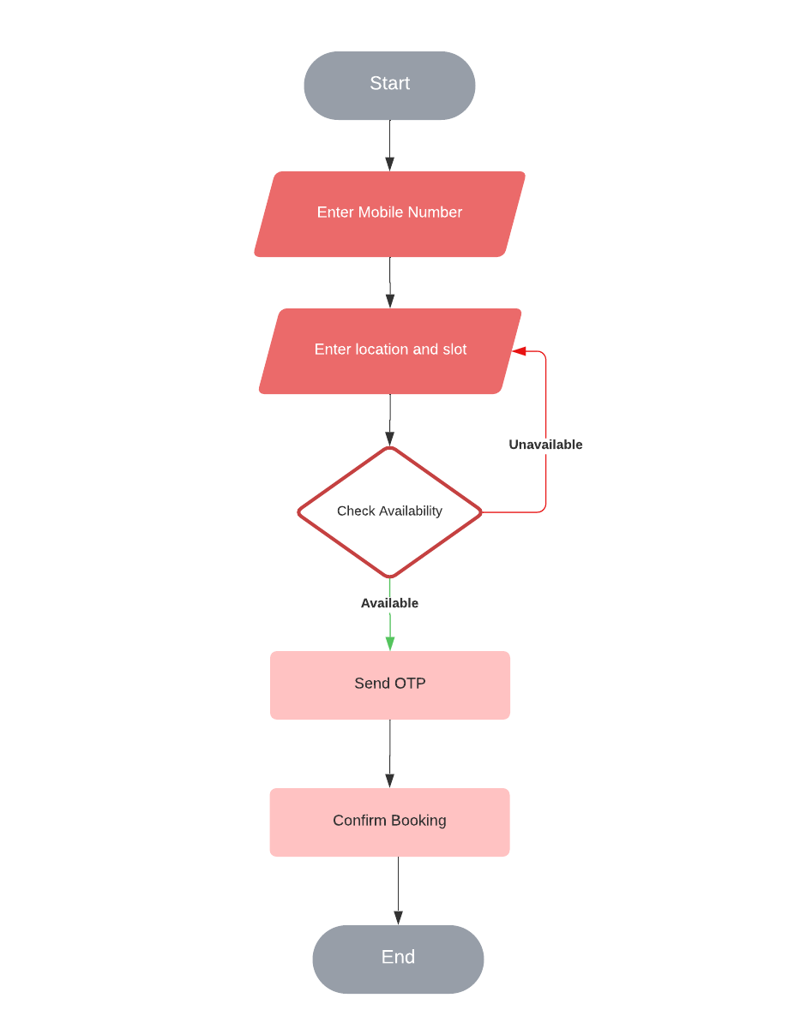


SYSTEM FLOWCHART
Booking
a parking slot

Slide 18
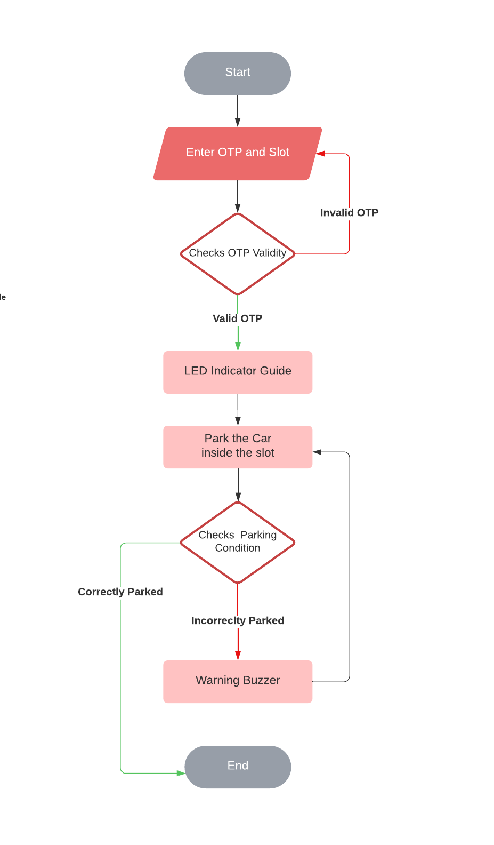
SYSTEM FLOWCHART
Parking a car

Slide 19
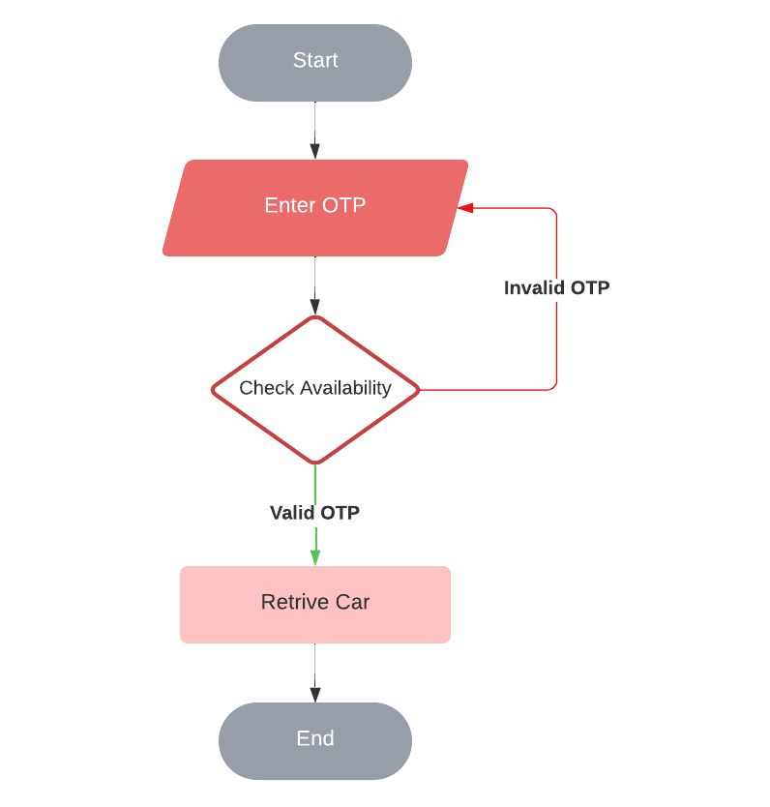
SYSTEM FLOWCHART
Retrieving a car

Slide 20
CONCLUSION
Implementation of IoT concept, software and network data
Can be consequential in overcoming currently existing parking issues
Expected to reduce traffic congestion by almost 50%

Slide 21
REFERENCES
Adler, L. (2016, February 18). How Smart City Barcelona Brought the Internet of Things to Life. Data-Smart City Solutions. Retrieved January 4, 2022, from https:// datasmart.ash.harvard.edu/news/article/how- smart-city-barcelona-brought-the-internet-of- things-to-life-789
Chand, S. J. B. (2021, March 19). Traffic jams cost Kathmandu Rs 116 billion a year: Study. Retrieved from https://english.onlinekhabar.com/traffic-jams-cost-kathmandu-rs-116-billion-a-year-study.html
Niculescu, A. I., Lim, M. Q., Wibowo, S. A., Yeo, K. H., Lim, B. P., Popow, M., Chia, D., & Banchs, R. E. (2015, September). Designing IDA - an Intelligent Driver Assistant for Smart City Parking in Singapore. Andreea Ioana Niculescu. https:// doi.org/10.1007/978-3-319-22723-8_50
Weishuber, C. (2015, May 5). Allianz | A sudden bang when parking. Allianz.Com. https://www.allianz.com/en/press/news/ commitment/community/150505-a-sudden- bang-when-parking.html

